Slide 1

Pulling Your Policies Together
Toni Nanne-Little and Frances Ryan
Board Members - Sault Ste. Marie Public Library
Notes:
Welcome everyone!
Introduction of presenters (done by Frances)

Slide 2
Overview
WHY… did we start?
WHAT…is your reality/experience? Let’s share!
WHO…was involved?
HOW…did we proceed?
Moving ahead……
Notes:
As we begin, we want to provide you with a brief overview of what we hope to share during our time together:
We will share why we started on this task of putting all of our policy pieces together.
We want to hear what your experience and reality is….and so in a few minutes you’ll have time to talk at your table.
We’ll share who was/is involved as we began.
We will share our process…and the challenges and opportunities that we encountered along the way…and the reasons we made the decisions we did.
We are not done our policy work! We’ll also share what we see as the work that still remains to be done.

Slide 3
WHY…did we start?
Policy development is fundamental to the work of the Board.
CEO’s have come and gone…
Board Members have come and gone…
There were policies….and policies….and more policies!
So many formats!!! So lengthy!!! So confusing!!! So many conflicting texts!!!
Review cycle was inconsistent.
Recognition that sometimes approach was reactive.
Notes:
We all know that policy development is the responsibility of the library board. Policy development is critical in ensuring that decisions made are consistent, supportive of the values and principles/mission of the library and reflective of current standards of good governance and legislative requirements. Good policies provide clear direction to staff and are consistently applied ensuring fairness, transparency and objectivity.
Our library was established in 1897 and until 2010 had five Chief Librarians or CEOs as they are now known. For one reason or another, we are now working with our third CEO over the last six years. Over this time we have had a series of revisions, implementation of new ones and others repealed.
Adding to the confusion were duplicates; conflicting policies; outdated policies and ghost policies - the ones everyone followed, but had never actually been committed to paper or to the Board for approval.
Several were found to be more a procedure than a policy. Some seemed to be reviewed repeatedly while others lay dormant with no updates whatsoever - regardless of any scheduled reviews.
Board members changed…some had strong understanding of rationale behind policies, varying degrees of understanding the importance of policy and monitoring/reviewing.
There were LOTS of policies….in many formats, in many places……and sometimes multiple policy versions of the same topic! Some policies were developed and implemented by CEO; some policies were developed in response to a problem and after the fact. Experienced board members recalled that “we had a policy on that”….but it was difficult to find the latest policy. Sometimes practice didn’t follow policy!
Some of the policies written were quite long and because of that, sometimes confusing. Often it was unclear to the reader what the policy was directing. In many cases, the policy was actually a procedure. There were multiple versions sometimes of the same policy….and the versions contradicted each other.
The review cycle was not defined or consistent…and this resulted in several policies being very outdated.
Policy sometimes was developed because of something that happened and was or wasn’t addressed satisfactorily.

Slide 4
WHY…did we start?
Our goal was to have clear and concise policies available to Board, Management, Staff and Public by creating a central, up-to-date website repository available to all.
We wanted to establish a timetable for consistent review and to update policies as necessary
Notes:
Our goal: We recognized that we needed to make this a priority for our Board if we were to have strong library, with everyone on the same page!
Thus– our goal ---refer to slide.

Slide 5

WHAT …is your reality/experience?
Let’s talk about where you are!
Let’s talk about where your Board is!
Notes:
We’ve shared why we got started….let’s talk about where you are at!
At your table, we’d like you to share with each other where you think your library board is with respect to policies. What’s been your experience (good and bad)? What’s been your biggest challenge? What’s been something you’ve been successful at?
Be prepared to share with the larger group. (Allow 10-15 minutes depending on size of group and level of interaction and participation).
NOTE: throughout the remainder of the presentation, try to make connections with what they give us.

Slide 6
WHO…was involved?
Established a committee of the Board
Worked with the CEO/Director of Public Libraries
Came to common understanding of Board/CEO responsibilities:
Board Responsibilities | CEO Responsibilities
Analyze CEO policy recommendations Debate policy issues and implications Approve policy Review and revise policies as necessary Taken from: Cut to the Chase: Ontario public library governance at-a-glance Sept. 2012 | Recommend policies Advise on policy framework and format Provide information sources and policy examples Establishes procedures for implementing policies Interprets policies & procedures to library staff and public Maintains policy manual and ensures its accessibility
Notes:
Our Board by-laws provide for committees to be struck and thus the Board established the Policy Committee. The task was to do a complete overhaul of the existing policies.
It should be noted that there was a Policy Committee is existence and much work had been started…but because of circumstances, the work didn’t always get to the Board for approval. (How much do we say here?????)
The Committee’s membership expanded and the work began.

Slide 7
HOW…did we proceed?
INVENTORIED and SORTED all existing policies
Determined ORGANIZATION and NUMBERING
Created a CHART with assigned policy numbers, name of policy, dates approved, and review dates
Designed a TEMPLATE/Format standard
Established a “Policy on Policy”!
Separated procedures from policies
Notes:
So…..we had a committee, we had the enthusiasm and commitment of the Board…..we were ready to begin!
Briefly, here’s the process we used……I’ll just go over them at a high level now and then we will share the nuts and bolts in detail of each.
(so over the broad topics shown on slide).

Slide 8
INVENTORY
Notes:
So first we had to get copies of all existing policies…..sounds easy???? Not really!
Some committee members had copies of policies, the CEO was able to provide some. We had reams of paper and multiple versions of policies.
This prompted us to recommend that we needed a better process for storing policies……we determined that all policies would be stored on an internal drive and posted on the library’s website. Paper copies of policy were discouraged, as we wanted to ensure that everyone would only be accessing the most current policy.

Slide 9
ORGANIZE NUMBERING SYSTEM
GOVERNANCE 100-
OPERATIONS 200-
BUSINESS/FINANCIAL 300-
HUMAN RESOURCES 400-
Notes:
We physically sorted all of the policies into piles…..we had determined that we would organize our policies into 4 categories: Governance. Operations, Business/Financial, Human Resources.
These were the categories that we felt made the most sense for our public library staff and public.
Then we figured out how we wanted them numbered…..we chose to use 100 series….for Governance so each policy pertaining to governance would be 100-01, 100-02, etc. We did the same for the other categories.

Slide 10
CHART
Policy Number
Name of Policy
Last Revision Date
Review date
Notes:
Once we had our piles of policies, we made a chart listing each category and the policies that fit. We assigned numbers, as the existing policies had all different ways they were numbered. This highlighted for the committee the importance of making sure that we had a template and consistent formatting as we moved forward. (we will speak about this in more detail in a few minutes).
This is when we realized that we had multiple versions of the same policy as well as several policies on the same topic….sometimes they contradicted each other. I should mention also that as we worked through this, sometimes we would find another version of a policy that was in someone’s files or on their computer. This highlighted why we needed a central repository for all policies!!

Slide 11

Notes:
Here is what our chart looked like.

Slide 12
Notes:
Here is what our chart looked like.

Slide 13

TEMPLATE
FORMATTING
Banner
Headings
Font type
Font size
Header and footer
“Widows and Orphans”
Notes:
We mentioned earlier that as we were compiling policies, we saw that the policies were in different formats, fonts, etc. This made the policies hard to read in some instances. As well, some of the policies were SO WORDY!!!! Recognizing that we wanted our policies to be accessible to all, we committed to using simple, direct language…and eliminating legal-ese and verbosity.
By ensuring consistency in format and sections, policies become more easily identified and accessed.

Slide 14
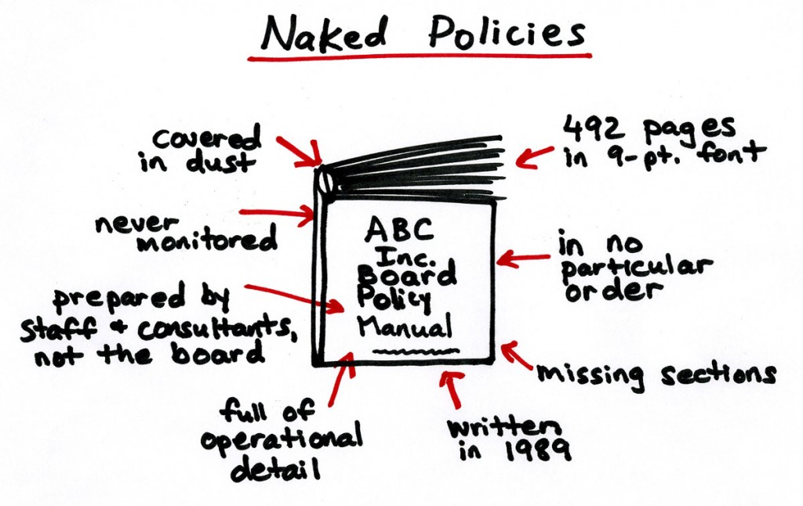
Notes:
Here is a sample of what we came up with……we are not saying that this is perfect, but at least it provided us with consistency as we moved forward.

Slide 15
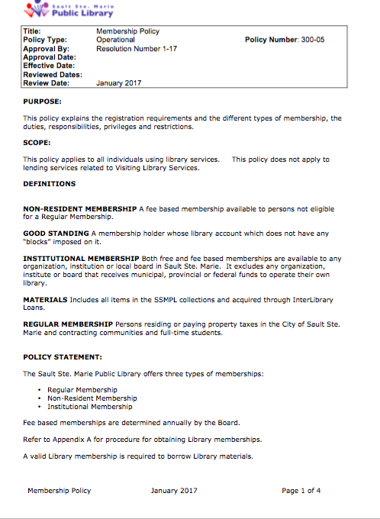

Slide 16
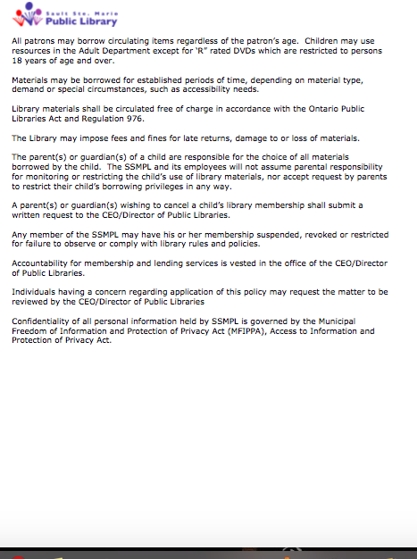

Slide 17
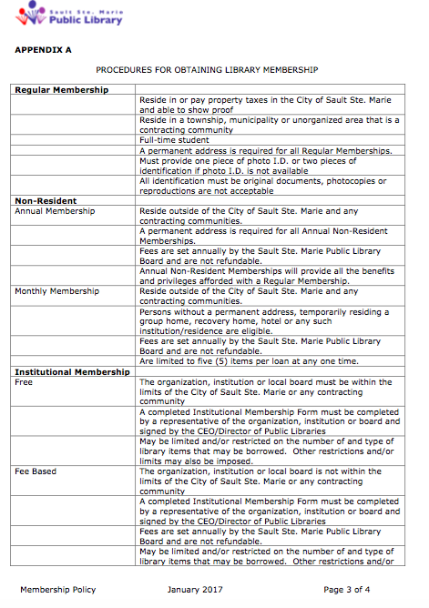

Slide 18
POLICY ON POLICY!
Board kept informed of our progress
Created a Policy on Policy Development to describe the process to be used for policy creation, approval and review
(Board approved this policy before we began the actual review process.)
Notes:
Because we had identified that previously, there had not been a consistent approach to either policy creation or policy review, we determined that we needed to ensure that we approached our work with a good process in order to bring about that consistency and clarity that we were seeking.
Thus, we developed a policy on policy development which the Board approved….this will ensure that the Board stays current and consistent with its policy work.

Slide 19


Notes:
So our policy puzzle is nearing completion……This has been our journey of putting the pieces of the policy puzzle together!
We haven’t yet finished! But we are well on our way!

Slide 20
Our SUCCESSES…
Providing organization to policies
Reducing the number of policies by eliminating duplication, consolidating or revoking where appropriate
Establishing a review cycle
Providing clarity by using simple language and eliminating irrelevant detail
Increasing awareness of library policy by Board members
We have been successful:
Notes:
We’ve made great strides ….(refer to slide)
Eliminating irrelevant material such as work processes and directives …this better belongs in procedures or administrative guidelines.

Slide 21
Our NEXT STEPS…
Ensuring the template is used; ensuring proper training for template creation
Ensuring policies are “proofed” prior to posting
Posting policies on website in a timely manner
Deterring “personal” copies – access policies from website
Ensuring policy is followed by all
We continue to be challenged:
Notes:
Our work is not finished! We still have some challenges!
(Refer to slide)
Staff are still on a learning curve with the recent implementation of a new website

Slide 22
Board members’ Resources
Ministry of Tourism, Culture and Sport
http://www.mtc.gov.on.ca/en/libraries/legislation.shtml
Public Libraries Act and Public Libraries Act, R.R.O. 1990, REGULATION 976
and additional legislation that may impact libraries.
Ontario Library Boards' Association
http://www.accessola.org/web/OLA/OLBA/Leadership_by_Design/OLA/OLBA/Leadership_by_Design/Leadership_by_Design.aspx?hkey=65ecadbf-bb5d-482d-99ba-4f5673d03faa
OLA and FOPL
http://www.learnhq.ca/news
Notes:
Here are some good resources…encourage you to access materials provided by OLBA, OLA and FOPL, as these resources provide good information

Slide 23

Notes:
(Any questions??)
Thank everyone for their attention and participation. Remember to make your comments on this session at (appropriate link) as they will be used to determine the types and subjects of future events

Slide 24


